Slide 1
Genomic surveillance reveals multiple introductions of SARS-CoV-2 into Northern California
Deng et al. (2020)
Molecular Epidemiology Case Study 3
MOLECULAR EPIDEMIOLOGY TRAINING SERIES
OCTOBER 9, 2026

Slide 2
Learning objectives
Identify potential sources of sampling bias in a genomic surveillance dataset, including geographic, temporal, clinical, and outbreak/cluster-related differences in sampling.
Explain how sampling bias can affect interpretation of genomic epidemiology findings, including apparent lineage distribution, introductions, transmission patterns, and source attribution.
Assess the robustness of genomic epidemiology conclusions by considering sampling coverage, missing populations, and how conclusions might change under alternative sampling or analytical approaches.

Slide 3
Background & context of the outbreak
Washington had an established WA1 transmission chain after the first U.S. case was identified on 19 January 2020.
By July 2020, California had reported >365,000 COVID-19 cases; reported counts underestimated infections because many infections were asymptomatic or mild.
California had limited real-time genomic epidemiology data. The study asked which SARS-CoV-2 lineages were circulating in Northern California and what their genomes could reveal about introduction and transmission.

Slide 4
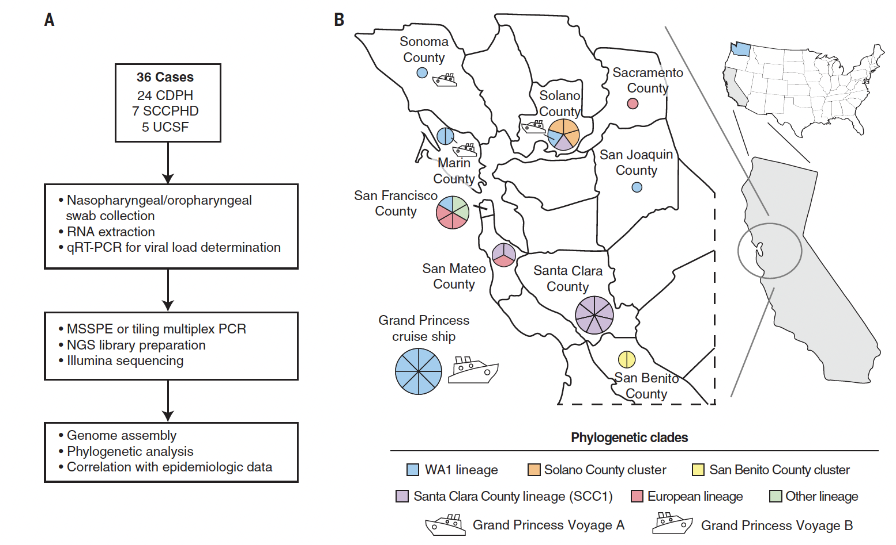
Methodology
• Screened 62 swabs from 54 patients. Genomes were recovered from 36 patients with >65% coverage; median coverage was 97.7% (IQR 90.4–99.7%).
• Samples represented Grand Princess cases, a Santa Clara workplace cluster, a Solano healthcare-associated cluster, travel, sick contacts, and community transmission.
•Generated phylogenetic tree along with 753 global sequences.
Notes:
MSSPE, metagenomic sequencing with spiked primer enrichment
SCCPHD, Santa Clara County Public Health Department
CDPH, California Department of Public Health
UCSF, University of California, San Francisco

Slide 5
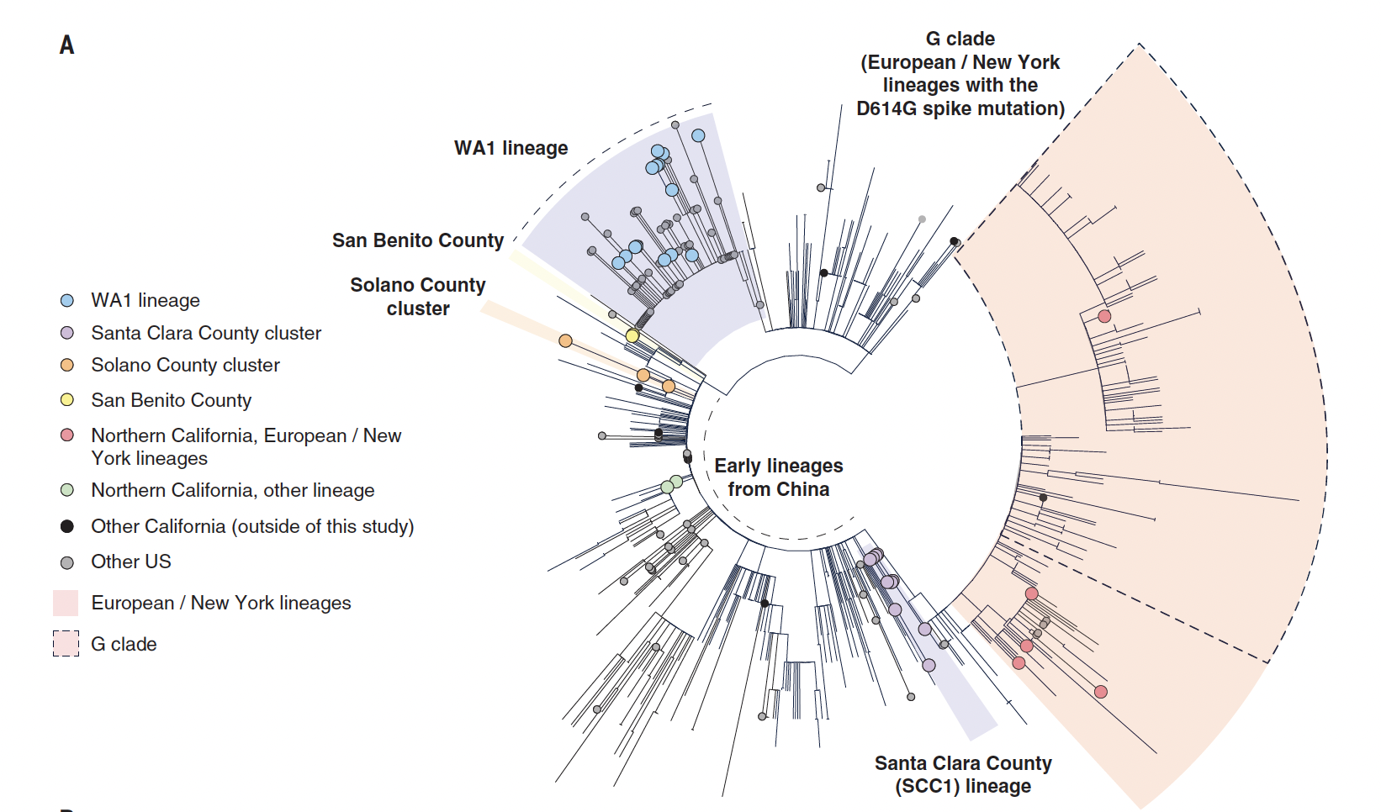
No predominant Northern California lineage
• All 36 California genomes were dispersed across the global SARS-CoV-2 tree.
• 14 genomes were in WA1; 10 in the Santa Clara SCC1 lineage; 3 in the Solano cluster; 5 related to Europe/New York; and 4 related to early Wuhan/China lineages.
Notes:
Circular phylogenetic tree

Slide 6
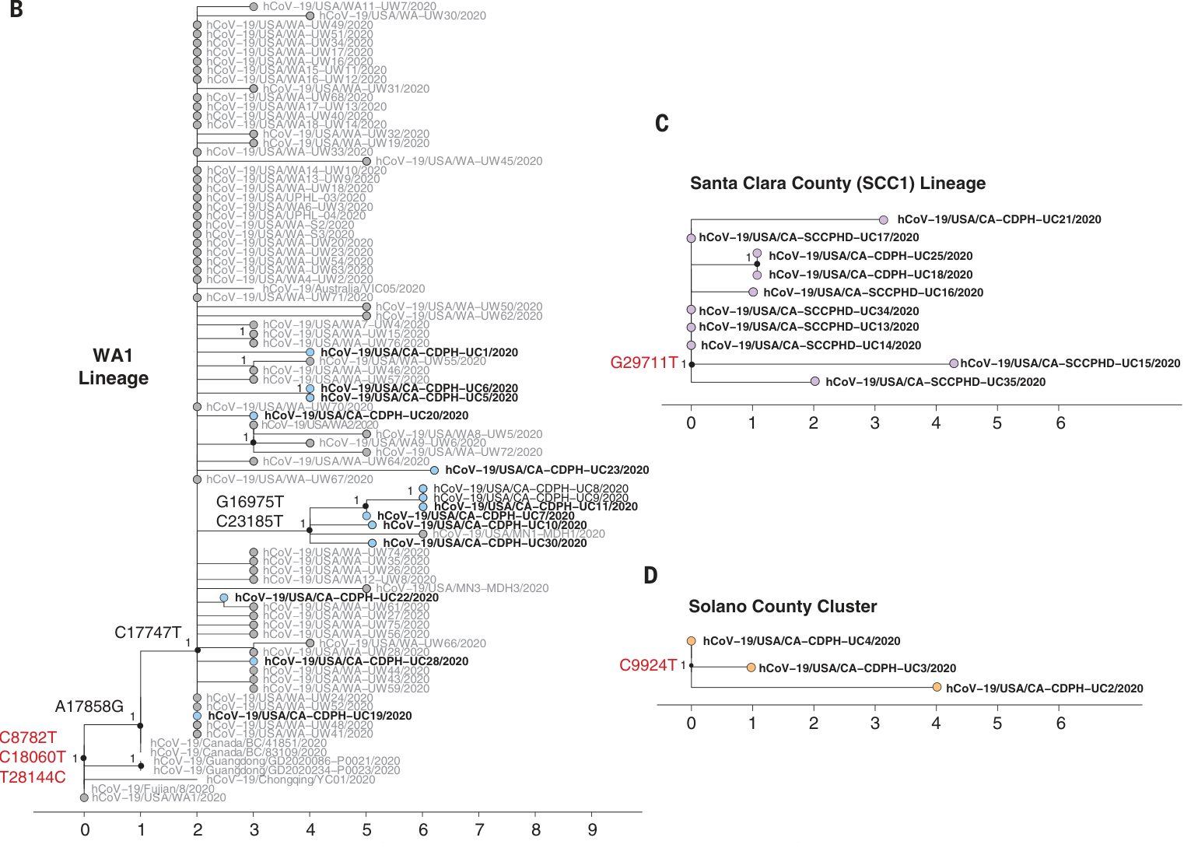
Multiple lineages circulating in Northern California
• All 11 sequenced Grand Princess genomes belonged to WA1.

Slide 7
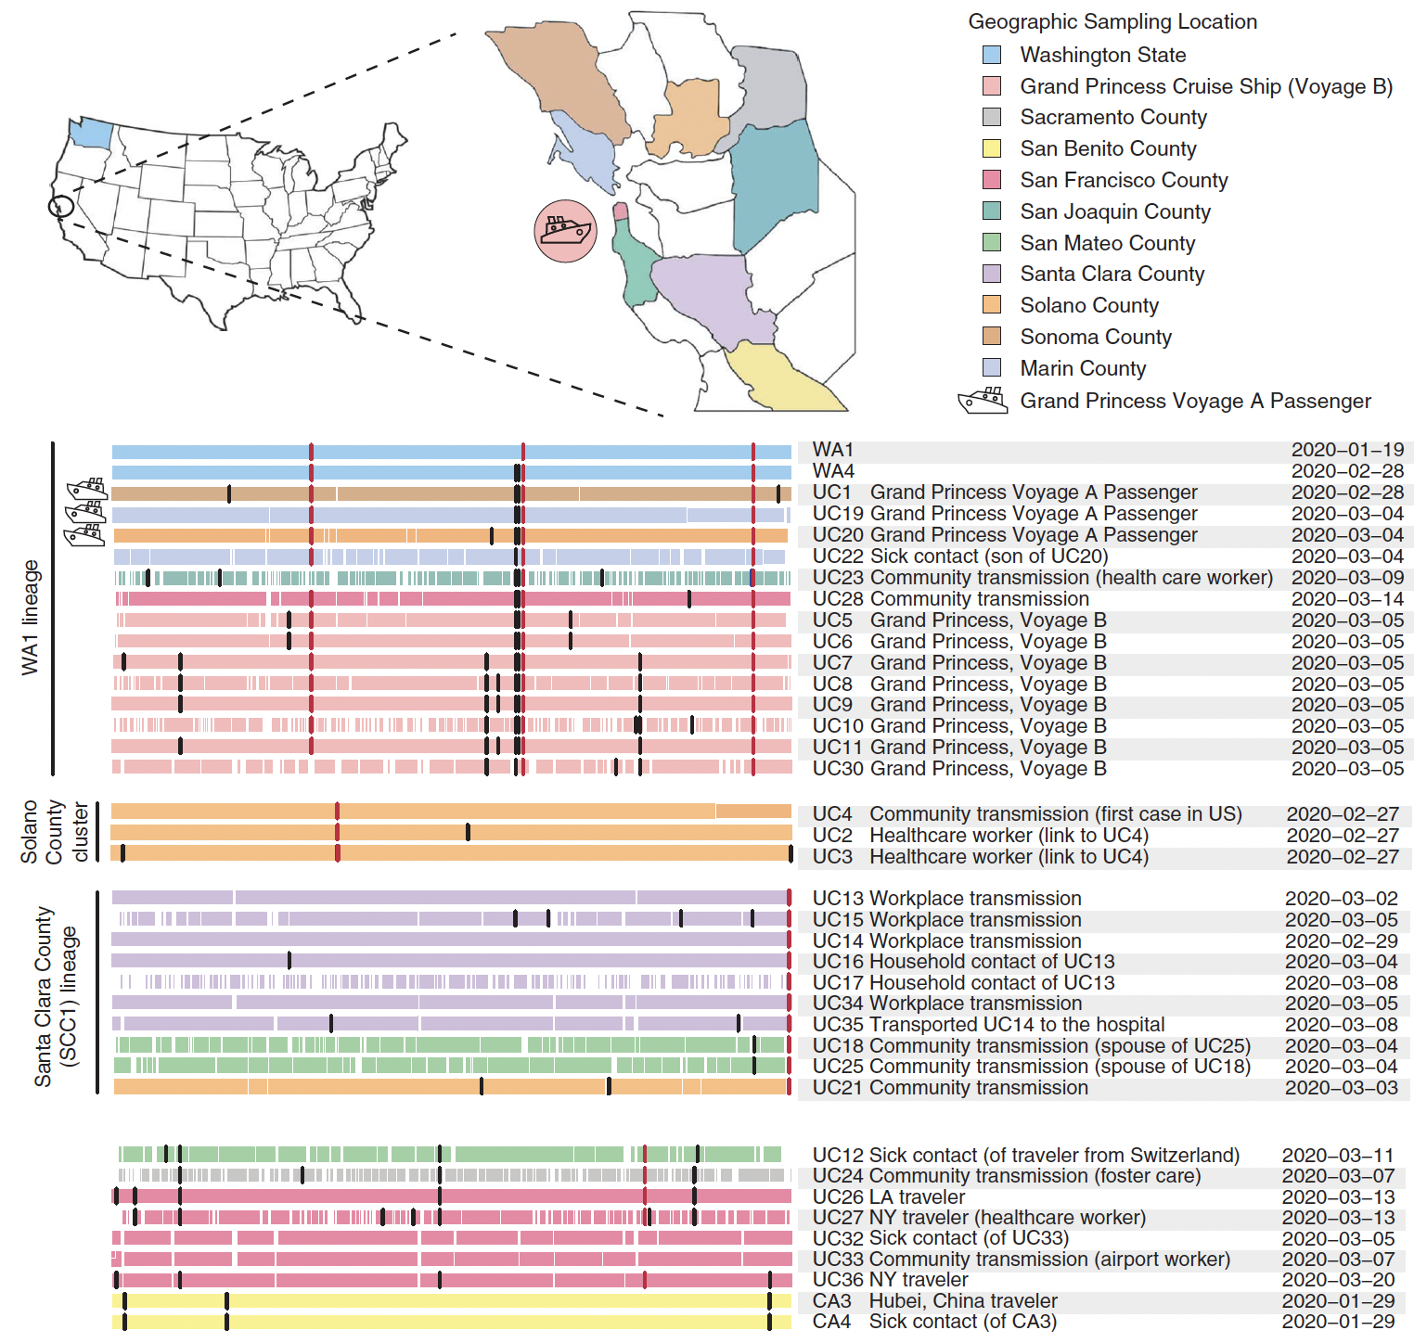
Specific mutations defined closely related clusters
• WA1 was defined by three SNVs: C8782T, C18060T, and T28144C.
• Grand Princess viruses shared C17747T and A17858G; voyage B viruses additionally shared G16975T and C23185T, which were absent from voyage A.
• Santa Clara SCC1 was defined by G29711T; the Solano County cluster by C9924T.
• The alignment illustrates how a small number of nucleotide changes can distinguish closely related lineages when combined with epidemiologic information.

Slide 8
Conclusions and considerations
• Northern California experienced multiple recent and unrelated introductions through different routes, including domestic and international travel and cruise-ship transmission.
• WA1 was established in multiple U.S. locations; the data were consistent with a Washington-to-California introduction.
• Study included several limitations
-Sparse sampling
-Many mild/asymptomatic infections were not tested
- Public-health laboratory samples may not represent the population
-Phylogenetic grouping does not prove direction of spread

